Slide 1



Time Series &
Exponential Growth
Mastering the Logic of Change, Navigating Trends, Seasonality, and Non-Linear Scaling.
WEEK 9
01 / 35
Notes:
1

Slide 2

SECTION 1
The Fourth
Dimension
Time as a variable that reshapes every other number
02 / 35
Notes:
2

Slide 3
Static data is a lie, the world is always moving
The Fourth Dimension: Time
Time is a variable that changes the meaning of every other data point
A sale in December isn't the same as a sale in July
Seasonality, inflation, and momentum all bend the numbers
A dollar today isn't a dollar tomorrow
We must ADJUST data for time before we can trust the analysis
03 / 35
Notes:
3

Slide 4




Components of a Time Series
Trend
Seasonality
Cycles
Noise
The long-term direction the data is moving over time.
Repeating, predictable patterns
e.g. the Q4 retail spike.
Long-term economic waves of irregular length.
Random, unexplainable variation left over.
if a Retail company spikes in Q4: is the company growing (Trend), or is it just Christmas (Seasonality)?
04 / 35
Notes:
4

Slide 5
Stationary vs. Non-Stationary
Stationary
Non-Stationary
Mean stays constant over time
Mean drifts over time
No persistent upward/downward drift
Constant upward creep breaks the math
Traditional statistics work well
Must be stabilized (Differencing)
Predictable and stable
Unreliable until adjusted
05 / 35
Notes:
5

Slide 6
The zoom level changes the story, pick the lens that fits your decision horizon.
The Sampling Frequency
Daily, Weekly, Monthly, or Tick-by-Tick
The 'Zoom' level changes the story
High-frequency data (Daily) shows the NOISE
Low-frequency data (Yearly) shows the STRATEGY
Choose the frequency that answers your question
06 / 35
Notes:
6

Slide 7

SECTION 2
Smoothing
the Noise
Filtering randomness to reveal the real trend underneath
07 / 35
Notes:
7

Slide 8
The longer the window, the smoother (and slower) the line.
Moving Averages
A 7-day moving average reveals the weekly cycle
A 12-month moving average reveals the business cycle
The longer the window, the smoother (and slower) the line
Choose the window that matches your decision horizon
The shorter the window, the noisier (and faster) the line
08 / 35
Notes:
8

Slide 9
(EWMA)
Exponentially Weighted Moving Average
New Forecast
=
Old Forecast + α × (Actual − Old Forecast)
Why weight recent data higher?
Alpha (α) controls how much weight we give to the newest observation. The higher the alpha, the faster the model adapts. In stocks or fast-fashion, yesterday can be 10x more important than a month ago.
09 / 35
Notes:
9

Slide 10

The index lets us set realistic, season-aware expectations.
Seasonal Indices
Measure how much a specific period deviates from the average
If 'May' is always 15% below average, its Seasonal Index is 0.85
The index lets us set realistic, season-aware expectations
10 / 35
Notes:
10

Slide 11

Deseasonalizing Data
Actual Value
÷
Seasonal Index
Why divide it out?
This exposes the underlying trend. It answers: 'If it weren't for the holiday spike, would we still be growing?'
11 / 35
Notes:
11

Slide 12

In many businesses the best predictor of tomorrow is today.
Autocorrelation (Lag Analysis)
How much does 'Today' correlate with 'Yesterday'?
In many businesses the best predictor of tomorrow is today
We call this a 'Lag-1' relationship
12 / 35
Notes:
12

Slide 13

You must reset the model, the past no longer describes the present.
Detecting Structural Breaks
A sudden shift from a new regulation, a pandemic, or a market shock
WARNING: after a structural break, your old history is 'Toxic'
You must reset the model, the past no longer describes the present
13 / 35
Notes:
13

Slide 14

One model captures all three moving parts of the series.
Triple Exponential Smoothing (Holt-Winters)
Accounts for Level, Trend, and Seasonality simultaneously
The 'Gold Standard' for retail forecasting
One model captures all three moving parts of the series
14 / 35
Notes:
14

Slide 15

SECTION 3
Exponential
Growth & Scaling
Escaping the linear trap, how the real world compounds
15 / 35
Notes:
15

Slide 16
Modern markets move exponentially: 1, 2, 4, 8, 16…
The Linear Trap
The danger of assuming the future is a straight line
Human brains are wired for linear thinking: 1, 2, 3…
Modern markets move exponentially: 1, 2, 4, 8, 16…
Underestimating exponential change is the classic analyst's mistake
16 / 35
Notes:
16

Slide 17
The Exponential Equation
Y
=
abᵗ
Reading the parts
'a' is your starting point; 'b' is your growth factor. If b > 1 you have growth. If b < 1 you have decay (a fading trend).
17 / 35
Notes:
17

Slide 18

Growth compounds on top of growth — each period's base is larger.
Compound Interest & Virality
If your user base grows 10% every month, you don't just add 10 users
You add 10, then 11, then 12.1, then 13.3…
Growth compounds on top of growth — each period's base is larger
18 / 35
Notes:
18

Slide 19
72......
The Rule of 72
72
÷
Growth Rate
A mental shortcut for doubling time
Grow 10% a year → double in ~7.2 years. Grow 10% a month → double in ~7.2 months. The rate changes everything.
19 / 35
Notes:
19

Slide 20
A curve becomes a straaight line, now regression can handle it.
Log-Linear Transformation
The Analyst's Secret: take the Natural Log (LN) of exponential data
A curve becomes a straight line
Now the Linear Regression tools from Week 7 can predict exponential growth
20 / 35
Notes:
20

Slide 21
In log-space, the slope IS the growth rate, read it straight off the line.
0.05
A slope of 0.05 in a log-linear model = a 5% growth rate per period
21 / 35
Notes:
21

Slide 22
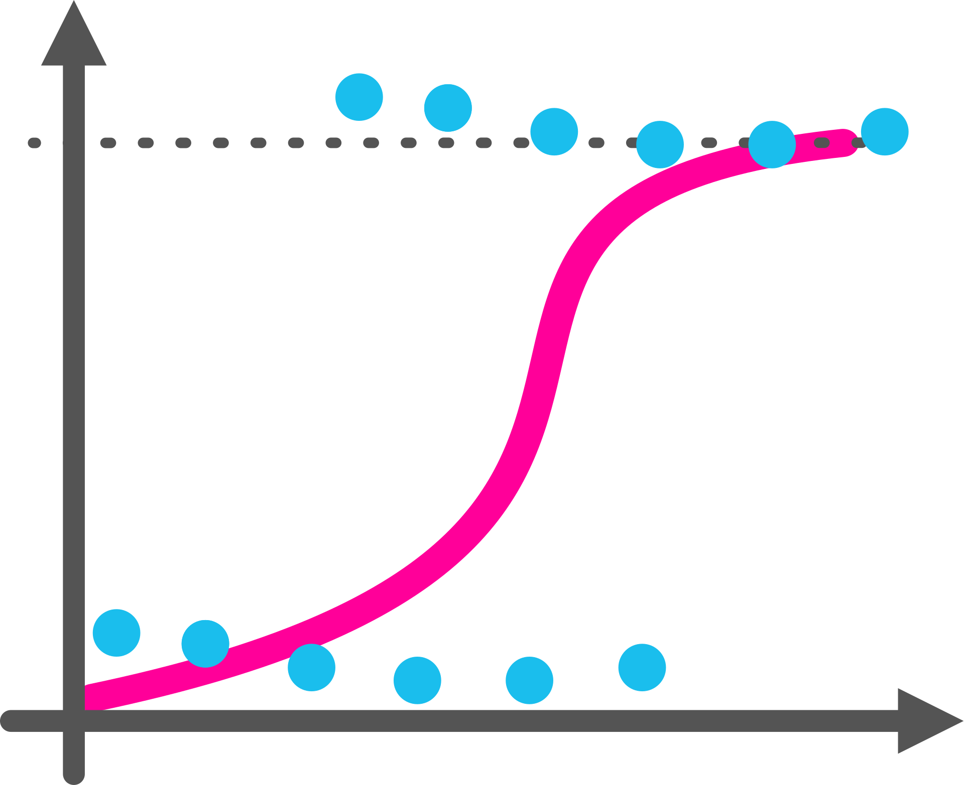
Growth accelerates, then bends over as the market fills up.
The S-Curve (Logistic Growth)
The reality of saturation — nothing grows forever
Facebook cannot grow forever: eventually everyone on Earth is already on it
Growth accelerates, then bends over as the market fills up
22 / 35
Notes:
22

Slide 23
The most dangerous moment for a CEO, and the most important for an analyst.
Inflection Points
The moment the curve stops accelerating and starts to flatten
The most dangerous moment for a CEO
...and the most important moment for an analyst to flag early
23 / 35
Notes:
23

Slide 24
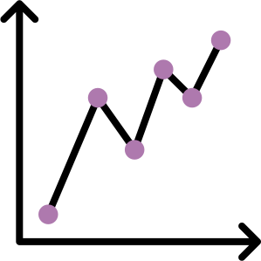
The spike is brief, plan capacity for the peak, not the plateau.
Forecasting Viral Content
Viral growth has a very sharp 'Up' and a very sharp 'Down'
We model this as a 'Log-Normal' distribution
The spike is brief, plan capacity for the peak, not the plateau
24 / 35
Notes:
24

Slide 25

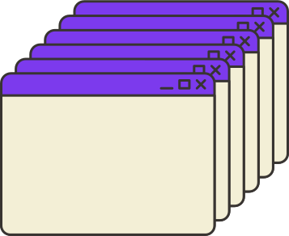
SECTION 3 • EXPONENTIAL GROWTH & SCALING
Excel's 'Forecast Sheet' Feature
1
2
3
Highlight Data
Data Tab
Forecast Sheet
>
>
Select your dated time-series range.
Open the Data tab in the ribbon.
Excel auto-detects seasonality + gives confidence bounds.
25 / 35
Notes:
25

Slide 26

SECTION 4
The Strategy
of Time
Turning forecasts into trustworthy, ethical decisions
26 / 35
Notes:
26

Slide 27
—— Precision vs. Accuracy in Time
"
It is better to be 'Approximately Right' about a trend than 'Precisely Wrong' about a single data point.
27 / 35
Notes:
27

Slide 28

Only test a model on data it could actually have seen at the time.
The 'Look-Ahead' Bias
WARNING: never use future information to 'predict' the past when testing
A common error that makes models look far better than they are
Only test a model on data it could actually have seen at the time
28 / 35
Notes:
28

Slide 29
Leading vs. Lagging Indicators
Leading
Lagging
Website visits
Revenue
Predicts future sales
Reports what already happened
Points to what's coming
Confirms the past
Great models lean on these
Necessary, but backward-looking
29 / 35
Notes:
29

Slide 30
It signals the trend has fundamentally changed.
Moving Averages as Support / Resistance
The moving average acts as a psychological floor and ceiling
If sales drop below the 12-month moving average — 'Red Alert'
It signals the trend has fundamentally changed
"
The best way to predict the future is to create it — but the second best way is to model it correctly.
30 / 35
Notes:
30

Slide 31
Your duty is to the math, not the morale.
Ethical Forecasting
Avoid 'Pessimistic Bias' and 'Optimistic Bias' in budget planning
Analysts are often pressured to make the future look 'Green'
Your duty is to the math, not the morale
We stop asking 'what will happen?' and start asking 'what should we DO?'
Next Week — Week 10
31 / 35
Notes:
31

Slide 32
Linear thinking would have cost the company millions in missed server capacity.
Homework: The Viral Content Tracker
You'll analyze the daily 'Views' of a viral video over 30 days
Prove why a 'Linear' forecast would have been catastrophic
Linear thinking would have cost the company millions in missed server capacity
Build the time series, a 7-day moving average, and an exponential trendline
33 / 35
Notes:
33

